Slide 1


Automated Detection of COVID-19 Cases in Digital Medical Images Using Deep Learning Approaches
Seminar presentation in Accordance with Partial Fulfillment of Requirements of Menoufia University for the Degree of Master in Computers and Information
Presented by:
Mahmoud Zaky Fetoh
Supervisors:
Prof: Khalid M. Amin
Dr: Ahmed M. Hamad

Slide 2
Acknowledgement
I would like to thank my supervisors and my teachers Dr. Ahmed M. Hamad and Prof. Khalid M. Amin for their help and guide during my Study.

Slide 3


Table of The Content
Introduction
Problem Statement
Related Work
Proposed Work I
Proposed Work II
Conclusion

Slide 4
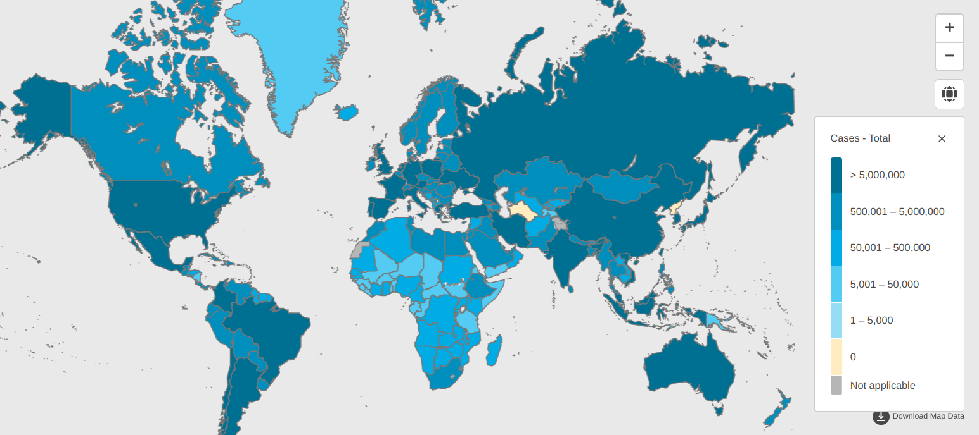
Introduction
Covid-19 is a contagious disease caused by severe acute respiratory syndrome coronavirus 2 (SARS-CoV-2).
Notes:
Corna virous disease or shortly (CoVID1) is a contagious disease that coused by sars-cov-2,
that can readily spread through direct or indirect contact with an infected person.
High spread rate put a persure on health care systems.

Slide 5
Introduction
Typical diagnostic tools for COVID-19 are :
Detection Approach | Description | Accuracy | Time to Results
RT-PCR | Detects genetic material of the virus through amplification of RNA | Highly accurate | Within a few hours
Rapid Antigen Test | Detects specific proteins on the surface of the virus | Less accurate than RT-PCR | Within minutes
Antibody Test | Detects the presence of antibodies against the virus in a blood sample | Not used to diagnose active infections, but can indicate past infections | Within a few hours to a few days
Chest Imaging | Uses chest X-rays or CT scans to detect COVID-19 pneumonia | Not used as a primary diagnostic tool, typically used in combination with other methods | depends on imaging procedure
Notes:
Typical diagnostic tools for covid19 is PCR.
PCR is time consuming and not available all time.

Slide 6
Introduction
How Hospitals react to CoViD-19?
low Lymphocytes
Covid19 pneumonia (Human involved)
Covid19 (P/N)
CBC Test
Chest X Ray
PCR test
Conclusion:
- Chest X-Ray diagnosis is time Consuming phase.
- Is there a chance of reducing that time ?

Slide 7

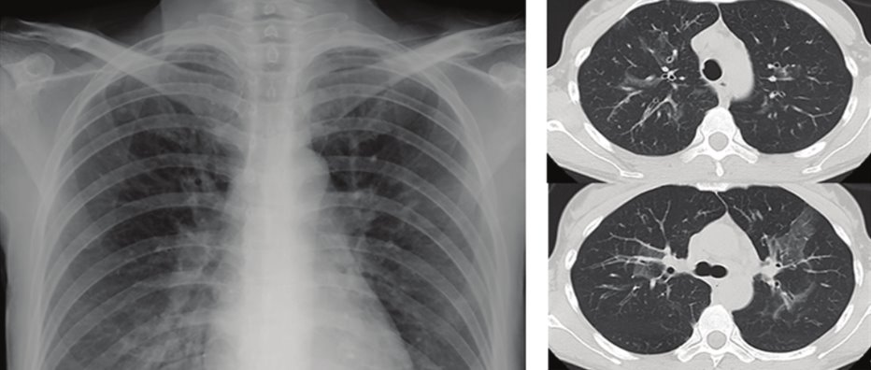
Introduction
CXR vs CT
Chest X-ray | CT scan
Quick and easy to acquire from the imaging device | More time-consuming and complex
Uses a small amount of radiation | Involves higher levels of radiation exposure
Less sensitive than CT scans in detecting abnormalities | More sensitive than chest X-rays in detecting abnormalities
Good for initial screening and detecting a wide range of abnormalities | Better for detecting smaller abnormalities and providing detailed information about their size, shape, and location
Less expensive | More expensive
May miss small lesions or nodules | More likely to detect small lesions or nodules
Notes:
An alternative medical images offer a fast screaning method for covid detection.
Common Medical images are ChestXRay (CXR) and CT.
CXR images are cheap, available and fast to acquire.
While it is not the case for ct

Slide 8
Table of The Content
Introduction
Problem Statement
Related Work
Proposed Work I
Proposed Work II
Conclusion

Slide 9

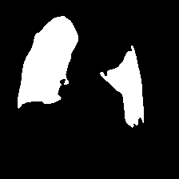
Problem Statement
Detection Challenges:
Viewpoint variation.
Illumination.
Deformation.
Occlusion.
Scale.
Szeliski, Richard. Computer vision: algorithms and applications. Springer Science & Business Media, 2010.
Notes:
So It is a detection problem. That has some challenges.
Viewpoin: represent the relative orientation change between the camera and object.
Illumination however this challenge does not relate our problem as radiology technician is responsible for fixing these conditions.
Same apply for illumination, deformation, occlution
However a scale has different consideration. Chest’s scale is fixed but the pnewminia scale changes.
For example these are two figures that represents the scale of two different patients
Left is large scale pnewmenia on the outher hand right is small scale pnewminia.

Slide 10
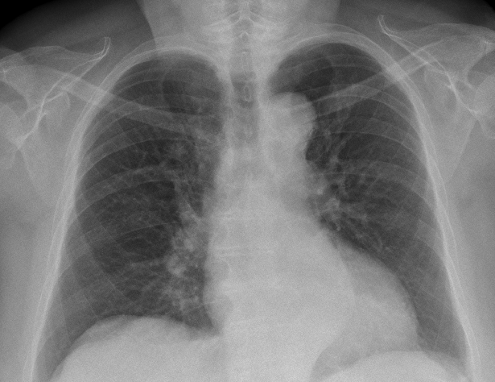
Problem Statement
Covid-19 detection using Convolutional Neural networks
CNN
Covid-19
OR
Not Covid-19
Notes:
For this work we use a CNN for COVID19 detection.

Slide 11
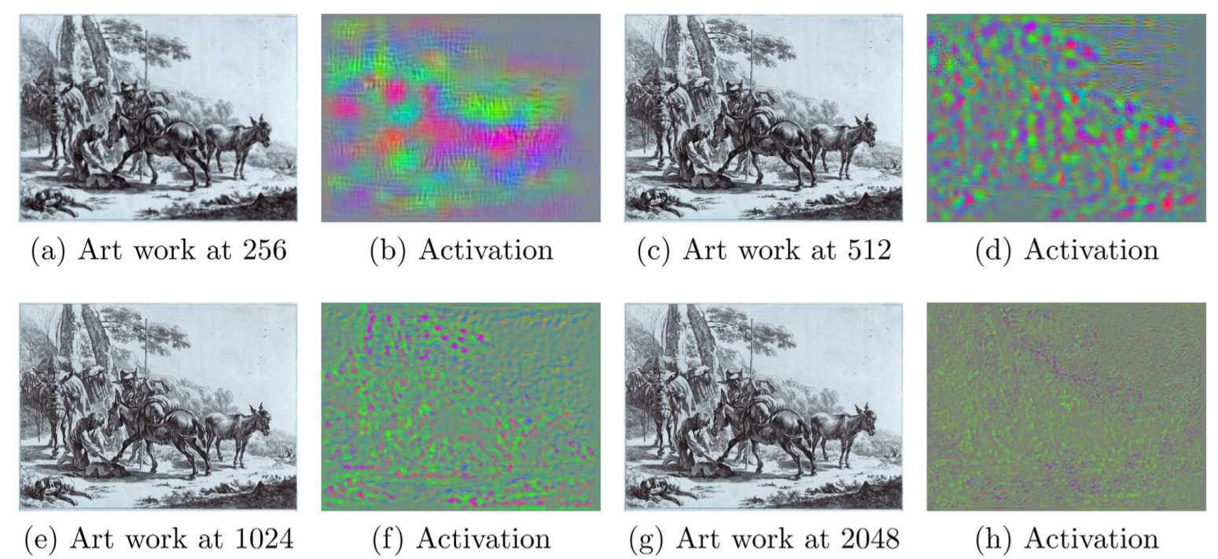
Problem Statement
Convolutional Neural Network is Scale variant
Notes:
CNN like many outher computer vision models are scale variant
meaning it can not recognize same object at a different scales.
For example given CNN trained on two handered and fivety six produce noisy out put as we increase the scale.

Slide 12
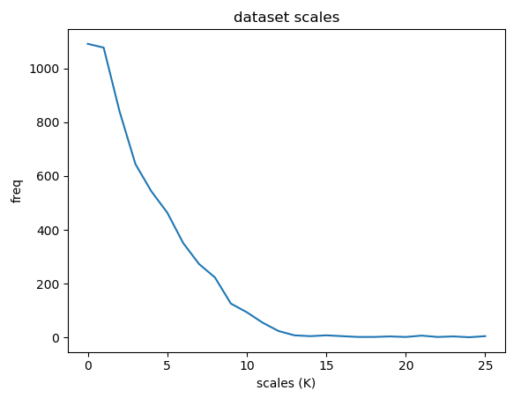
Problem
Statement
Statistical distribution of the pneumonia scale
Notes:
I’ve explored the scale statistical distribution of the training set.
It does not exhibt a uniform distribution.
As consequence CNN will recognize small scale but not large scales.

Slide 13
Problem Statement
Convolutional Neural Networks Sizes
Name CNN | Parameter Number
Alex-Net | 62.3M
VGG-16 | 138M
ResNet-152 | 60M
DenseNet-121 | 7.2M
MobileNet | 13M

Slide 14
Research objective
Reduce human power gap between covid19 patients and number of radiologists with high accuracy low analysis time.
Accuracy
Analysis time

Slide 15
Table of The Content
Introduction
Problem Statement
Related Work
Proposed Work I
Proposed Work II
Conclusion

Slide 16
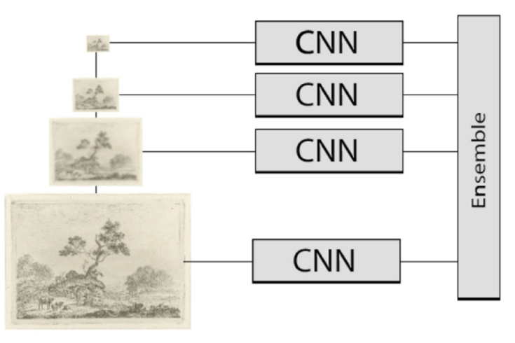
Related Work 1
Explicit multiscale training
Notes:
First approach for handling scale variabtion is to build the scale space of the input Image and train a separite network for each scale.
Drawbacks of this approach is that it not only expensive during training but also the ensemble of these network at the evalution time is not feasible for deployment.

Slide 17
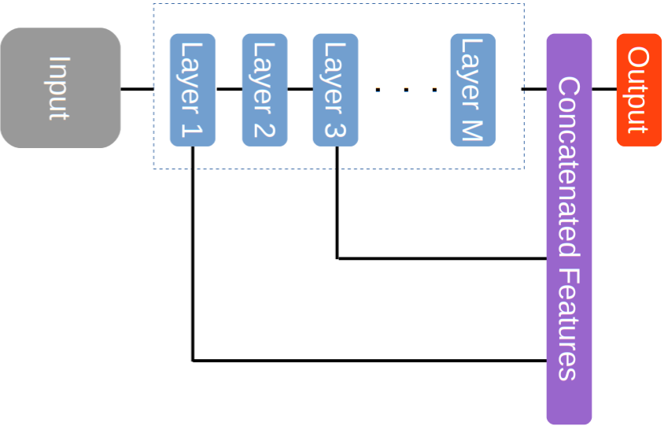
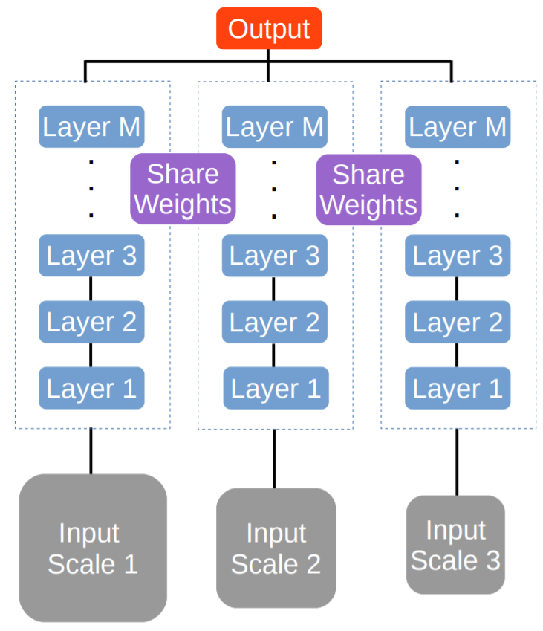
Related Work 2
Shared Networks and skip connection
Chen, Liang-Chieh, et al. "Deeplab: Semantic image segmentation with deep convolutional nets, atrous convolution, and fully connected crfs." IEEE transactions on pattern analysis and machine intelligence 40.4 (2017): 834-848.​
Notes:
Shared network solution in which we train a single network with the scale space of the input ButHow? CNN does not accept a variable size input. Vgg paper publish two thousand fiveteen. Suggests that extractin five crops from each scale and avg the results of these crops.
Skip connection in which we concatenate the feature from the lower layer and feature from higher layers. Since lower layer have smaller receptive field which captures small scales however higher layer has larger receptive field which can capture the larger scales.

Slide 18
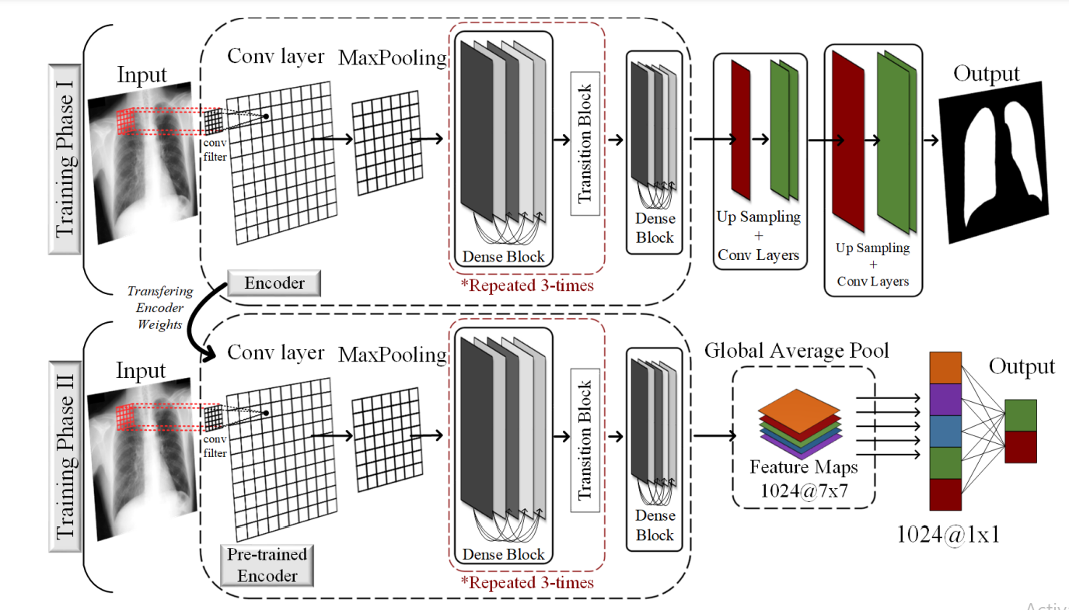
Related Work
ReCovNet ( Architecture )
Degerli, Aysen, et al. "Reliable COVID-19 Detection Using Chest X-ray Images." 2021 IEEE International Conference on Image Processing (ICIP). IEEE, 2021.

Slide 19
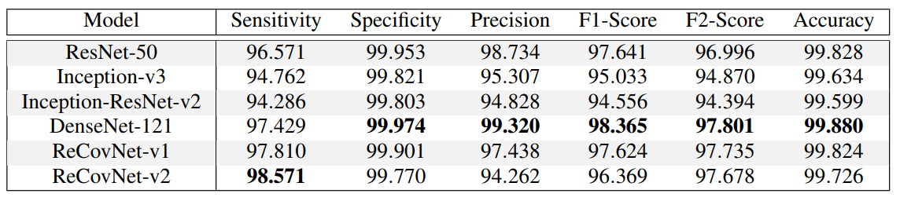
Related Work
ReCovNet ( RESuLT )
Degerli, Aysen, et al. "Reliable COVID-19 Detection Using Chest X-ray Images." 2021 IEEE International Conference on Image Processing (ICIP). IEEE, 2021.

Slide 20
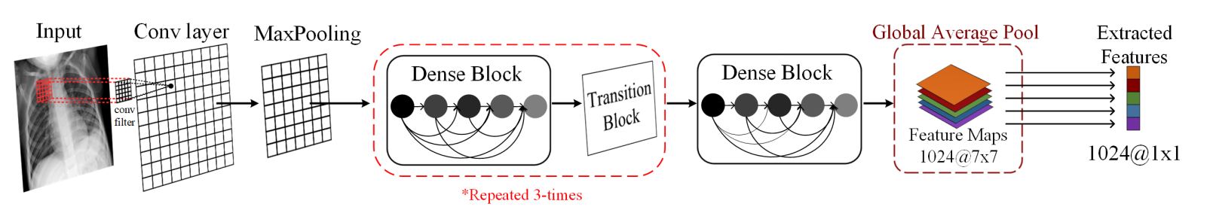
Related Work
2) Ahishali et al. (Architecture)
M. Ahishali et al., "Advance Warning Methodologies for COVID-19 Using Chest X-Ray Images," in IEEE Access, vol. 9, 2021

Slide 21
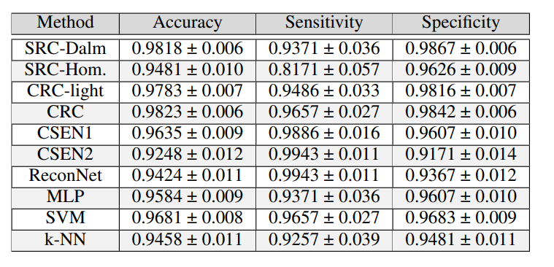
Related Work
2) Ahishali et al. (Results)
M. Ahishali et al., "Advance Warning Methodologies for COVID-19 Using Chest X-Ray Images," in IEEE Access, vol. 9, 2021

Slide 22
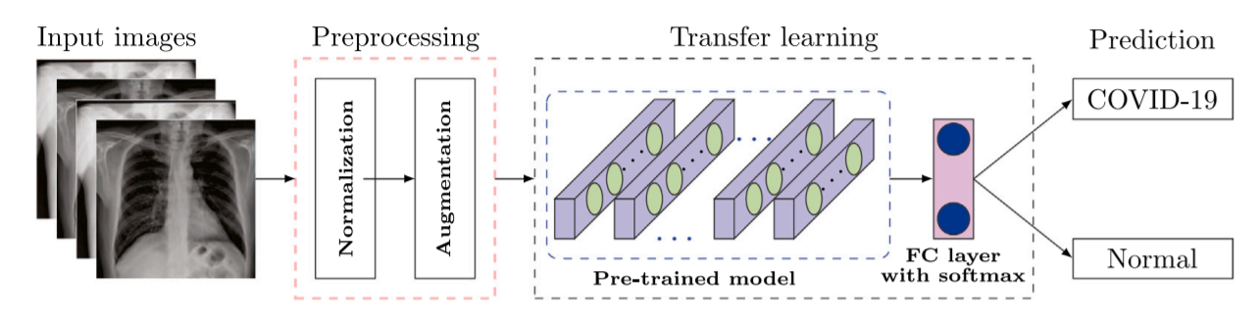
Related Work
3) Nayak, Soumya Ranjan, et al. ( Architecture )
Nayak, Soumya Ranjan, et al. "Application of deep learning techniques for detection of COVID-19 cases using chest X-ray images: A comprehensive study." Biomedical Signal Processing and Control 64 (2021)

Slide 23
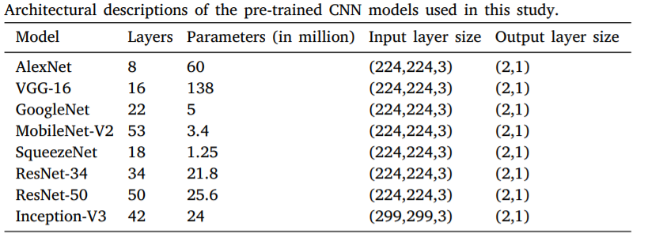
Related Work
3) Nayak, Soumya Ranjan, et al. (Results)
Nayak, Soumya Ranjan, et al. "Application of deep learning techniques for detection of COVID-19 cases using chest X-ray images: A comprehensive study." Biomedical Signal Processing and Control 64 (2021)

Slide 24
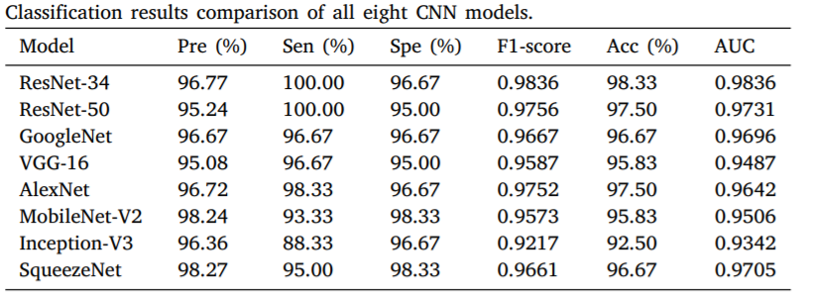
Related Work
3) Nayak, Soumya Ranjan, et al. ( Results)
Nayak, Soumya Ranjan, et al. "Application of deep learning techniques for detection of COVID-19 cases using chest X-ray images: A comprehensive study." Biomedical Signal Processing and Control 64 (2021)

Slide 25
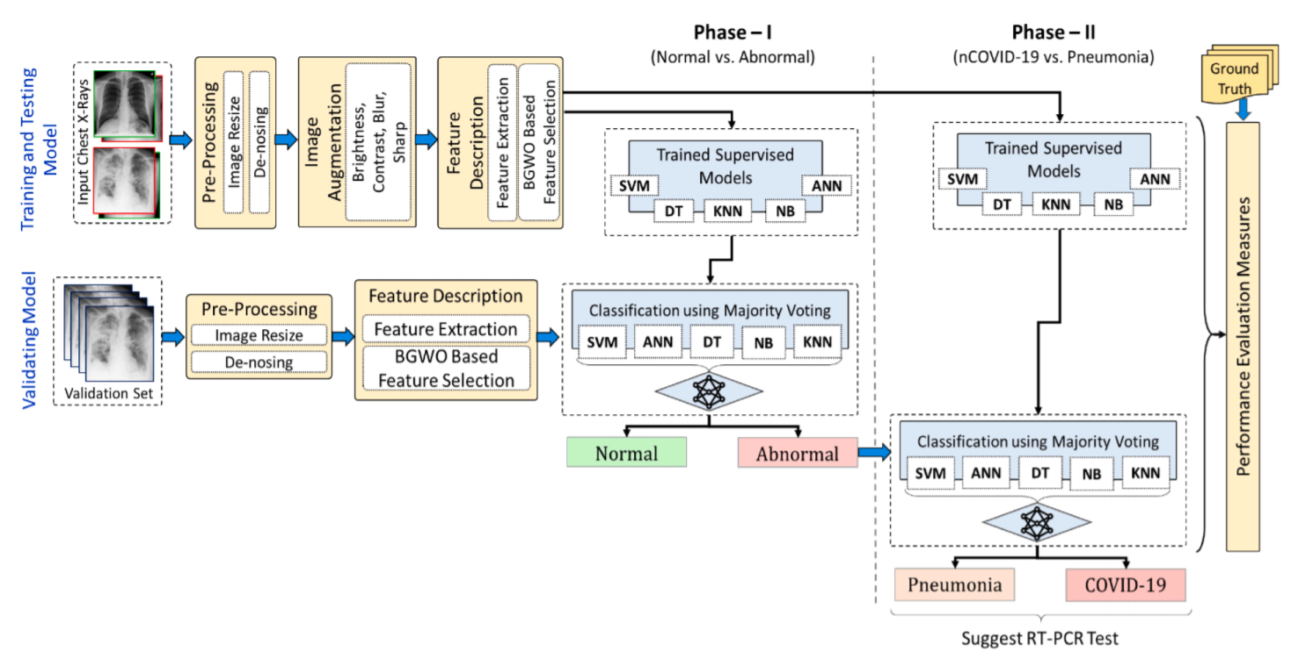
Related Work
4) Chandra, Tej Bahadur, et al. (Architecture)
Chandra, Tej Bahadur, et al. "Coronavirus disease (COVID-19) detection in Chest X-Ray images using majority voting based classifier ensemble." Expert systems with applications 165 (2021)

Slide 26
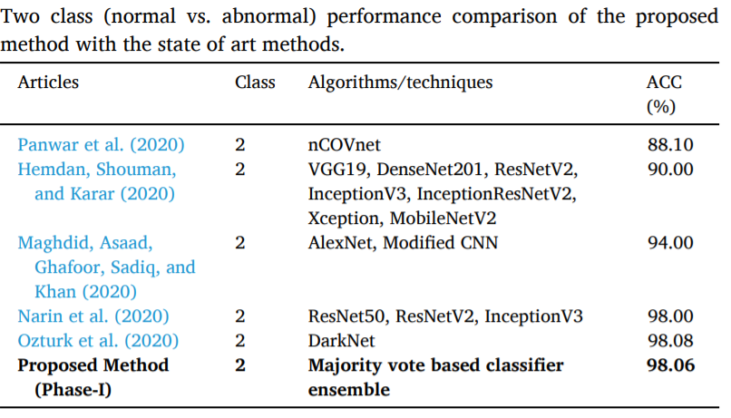
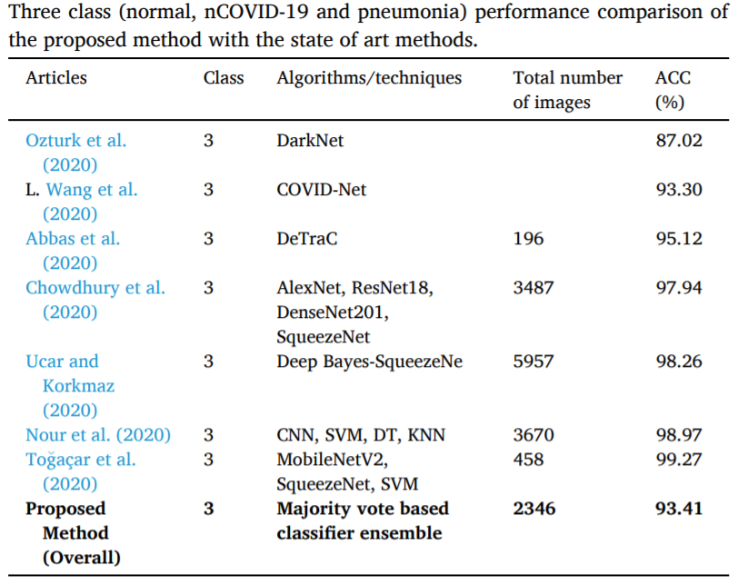
Related Work
4) Chandra, Tej Bahadur, et al. (Results)
Chandra, Tej Bahadur, et al. "Coronavirus disease (COVID-19) detection in Chest X-Ray images using majority voting based classifier ensemble." Expert systems with applications 165 (2021)

Slide 27
Related Work
Disadvantages :
Does not handle scale variant problem.
Computationally expensive ( High Analysis Time ).
Increase Accuracy for imbalanced dataset.

Slide 28
Table of The Content
Introduction
Problem Statement
Related Work
Proposed Work I
Proposed Work II
Conclusion

Slide 29
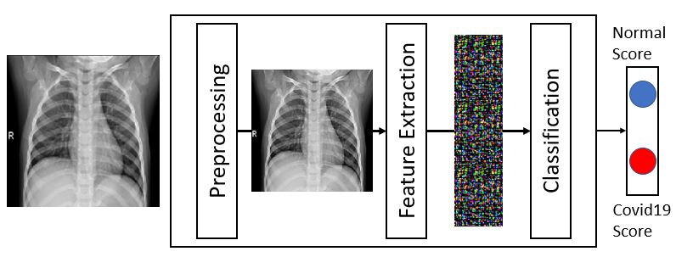
Proposal I
Methodology

Slide 30
Proposal I
Methodology (preprocesing)
Resizing
to shape of (200,200)
Normalization using learnable parameter
CXR Image
Resized Image

Slide 31
Proposal I
Methodology ( Feature Extraction )
*
*
H
H
H
1
N
D
MxM kernel
W
1x1xN
kernel
W
W
Depth-wise Separable Convolution

Slide 32
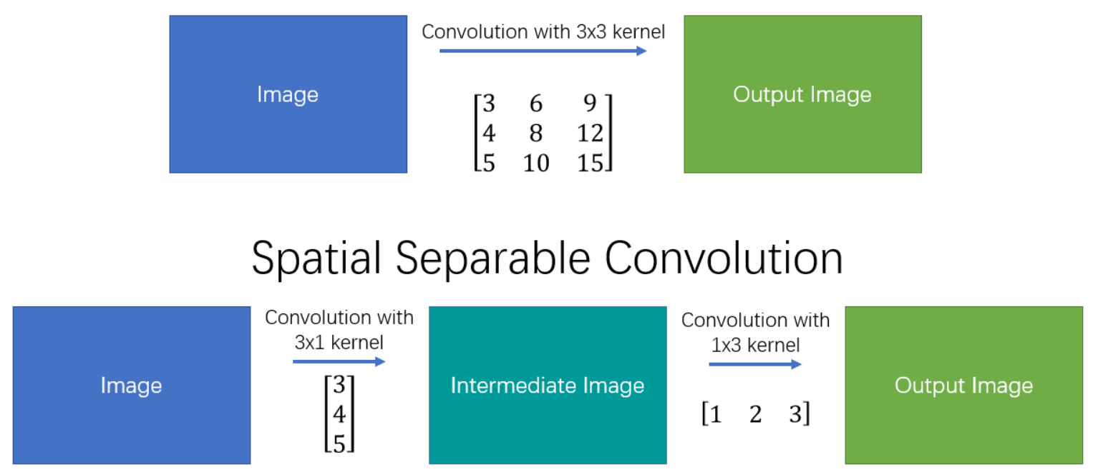
Proposal I
Methodology ( Feature Extraction )
Spatial Separable Kernels

Slide 33
Proposal I
Methodology ( Feature Extraction )
Advantage
Apply kernel separability and depthwise separable convolutions
- Reduces model overfitting by forcing the model to learn separable kernels.
- Fast processing
Lower parameter Count.
Reduces model overfitting
Drawback
Too Simple to detect Complex pattern
Conv Mx1(D)*
Conv1xM(D)*
DxWxH
N Conv1x1 (D)
NxWxH

Slide 34
Proposal I
Methodology ( Feature Extraction )
Drawback
High Covariate Shift
Risk of model overfitting
DxWxH
Activation Function
Activation Function
Activation Function
NxWxH
Separated Layer
Separated Layer
Separated Layer
Separated Layer
Separated Layer
Separated Layer
Separated Layer
Separated Layer
Activation Function
Separated Layer
Separated Layer
Separated Layer
Separated Layer
Separated Layer
Separated Layer
Separated Layer
Separated Layer
Separated Layer
Separated Layer
Separated Layer
Separated Layer
Separated Layer
Separated Layer
Activation Function
Activation Function
Activation Function
Activation Function
Activation Function
Activation Function
Activation Function
Activation Function
Activation Function
Activation Function
Activation Function
Activation Function
Activation Function

Slide 35
Proposal I
Methodology ( Feature Extraction )
Drawback
Small Receptive field.
DxWxH
Separated Layer
NxWxH
Separated Layer
Separated Layer
Separated Layer
Separated Layer
Separated Layer
Separated Layer
Separated Layer
Separated Layer
Separated Layer
Separated Layer
Separated Layer
Separated Layer
Separated Layer
Separated Layer
Separated Layer
Separated Layer
Separated Layer
Separated Layer
Separated Layer
Separated Layer
Separated Layer
Batch Normalization
Batch Normalization
Batch Normalization
Batch Normalization
Batch Normalization
Batch Normalization
Activation Function
Activation Function
Activation Function
Activation Function
Batch Normalization
Activation Function
Batch Normalization
Batch Normalization
Batch Normalization
Batch Normalization
Batch Normalization
Batch Normalization
Activation Function
Activation Function
Activation Function
Activation Function
Activation Function
Activation Function
Activation Function
Batch Normalization
Batch Normalization
Batch Normalization
Batch Normalization
Batch Normalization
Batch Normalization
Activation Function
Activation Function
Activation Function
Activation Function
Activation Function
C

Slide 36
Proposal I
Methodology ( Feature Extraction )
Advantage
Large Receptive field.
Reduces overfitting.
Reduces the vanishing gradient problem.
Reduces covariate shift.
DxWxH
Separated Layer
NxWxH
Separated Layer
Separated Layer
Separated Layer
Separated Layer
Separated Layer
Separated Layer
Separated Layer
Separated Layer
Separated Layer
Separated Layer
Separated Layer
Separated Layer
Separated Layer
Separated Layer
Separated Layer
Separated Layer
Separated Layer
Separated Layer
Separated Layer
Separated Layer
Separated Layer
Batch Normalization
Batch Normalization
Batch Normalization
Batch Normalization
Batch Normalization
Batch Normalization
Activation Function
Activation Function
Activation Function
Activation Function
Batch Normalization
Activation Function
Batch Normalization
Batch Normalization
Batch Normalization
Batch Normalization
Batch Normalization
Batch Normalization
Activation Function
Activation Function
Activation Function
Activation Function
Activation Function
Activation Function
Activation Function
Batch Normalization
Batch Normalization
Batch Normalization
Batch Normalization
Batch Normalization
Batch Normalization
Activation Function
Activation Function
Activation Function
Activation Function
Activation Function
C
residual separated block
Kernel Size for each Separated Layer is 3, 5, 7, and 9 Respectively
C : is a channel wise concatenation

Slide 37
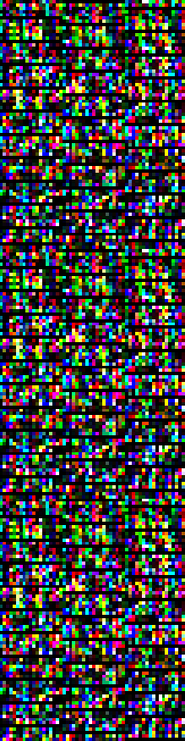
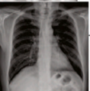
Proposal I
Methodology ( Feature Extraction )
Residual Separated Block
Residual Separated Block
Residual Separated Block
Residual Separated Block
Batch Normalization
Batch Normalization
Pooling
Activation Function
Activation Function
Batch Normalization
Pooling
Batch Normalization
Activation Function
Activation Function
Pooling
Pooling

Slide 38
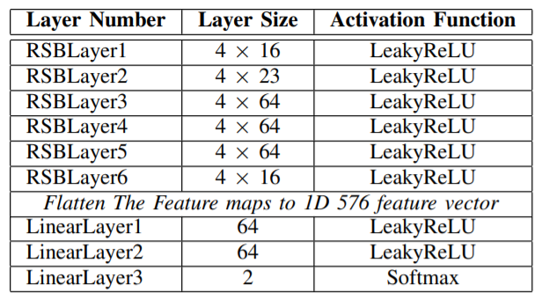
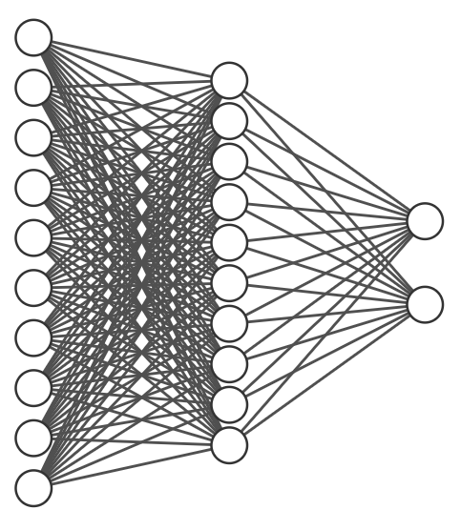
Proposal I
Methodology ( Feature Extraction )
Residual Separated Block
Residual Separated Block
Preprocessing
Residual Separated Block
•••
Residual Separated Block
Batch Normalization
Batch Normalization
Activation Function
Pooling
Activation Function
Pooling
Batch Normalization
Pooling
Batch Normalization
Activation Function
Activation Function
Pooling
Full Model

Slide 39
EXPERIMENTAL RESULTS I
Data Set and Machine specification
benchmark QaTa-COV19 dataset is used:
8284 Chest X-Ray image is used for training
first 4142 normal Chest X-Ray samples
All 4142 Covid-19 samples
922 Chest X-Ray image is used for testing
461 normal Chest X-Ray samples
461 Covid-19 samples
Experiments are conducted on :
Lenovo Z50-70,
Intel CORE i7-4510U CPU 2.00 GHz,
8GB RAM,
NVIDIA GeForce 840M GPU;
and with python and PyTorch library.

Slide 40
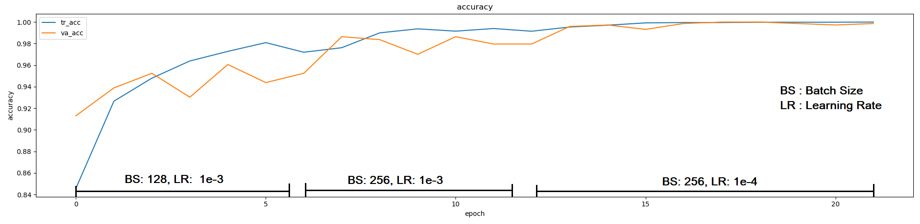
EXPERIMENTAL RESULTS I
Training

Slide 41
EXPERIMENTAL RESULTS I
Model Evaluation
$\text{\%}$

Slide 42
EXPERIMENTAL RESULTS I
Model Evaluation
Proposed Method (150K)
${10}^{6}$

Slide 43
Table of The Content
Introduction
Problem Statement
Related Work
Proposed Work I
Proposed Work II
Conclusion

Slide 44
Objective of Proposal II
Pneumonia scale change from one sample to other.
Notes:
So It is a detection problem. That has some challenges.
Viewpoin: represent the relative orientation change between the camera and object.
Illumination however this challenge does not relate our problem as radiology technician is responsible for fixing these conditions.
Same apply for illumination, deformation, occlution
However a scale has different consideration. Chest’s scale is fixed but the pnewminia scale changes.
For example these are two figures that represents the scale of two different patients
Left is large scale pnewmenia on the outher hand right is small scale pnewminia.

Slide 45
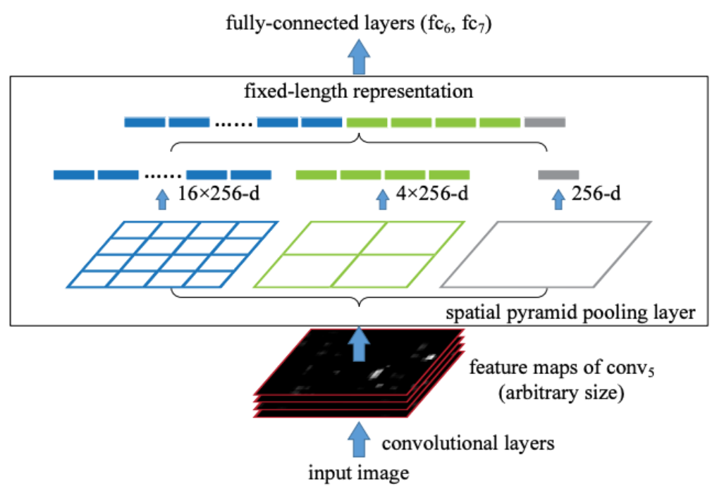
Proposal II
Spatial Pyramid Pooling Network
He, Kaiming, et al. "Spatial pyramid pooling in deep convolutional networks for visual recognition." IEEE transactions on pattern analysis and machine intelligence 37.9 (2015)
Notes:
Spatial Pyramid Pooling Network is a solution proposed by kaming he on two thousand fiveteen, that overcome the size limition of the CNN. This limition originate from the fact that dense base only accept a fixed length feature vector. Spp solution is based on injecting a spp layer between the dense and convbase the layer produces a fixed length feature vector

Slide 46
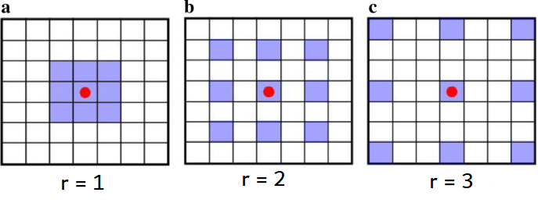
Proposal II
Dilated filters (atrous convolution)
Chen, Liang-Chieh, et al. "Deeplab: Semantic image segmentation with deep convolutional nets, atrous convolution, and fully connected crfs." IEEE transactions on pattern analysis and machine intelligence 40.4 (2017)
Notes:
Instead of creating the scale space of the input image which is expensive we can create the scale spaceof the kernel it self.
It done upsampling the kernel. For example figure (A) represent the convolution with atrous rete of one.
Figure (B) represent the same kernel with atrous rate of 2 it Done by introducing (r -1) between the kernel values.
Advantages of dilated convolution is that it increased the receptive field without neither introducing additional parameter nor a computational complexity.

Slide 47
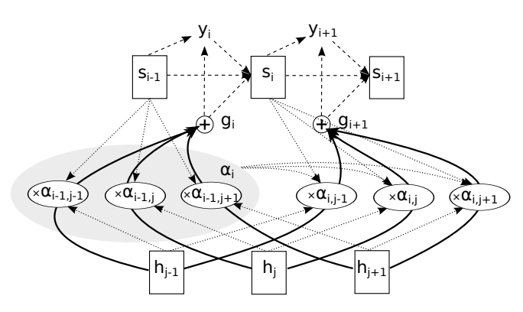
Proposal II
Attention seq2seq
Chorowski, J. K., Bahdanau, D., Serdyuk, D., Cho, K., & Bengio, Y. (2015). Attention-based models for speech recognition. Advances in neural information processing systems
Notes:
Attention initially proposed by yosha bingo in two thousand fourteen in NLP sequence to sequence medeling. In which he separite ecoder decoder architecture with an attention layer.

Slide 48

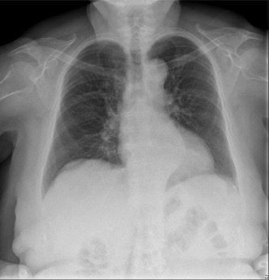

Proposal II
Methodology
Texture Aug.
Standard Aug.
Proposed CNN Model

Slide 49
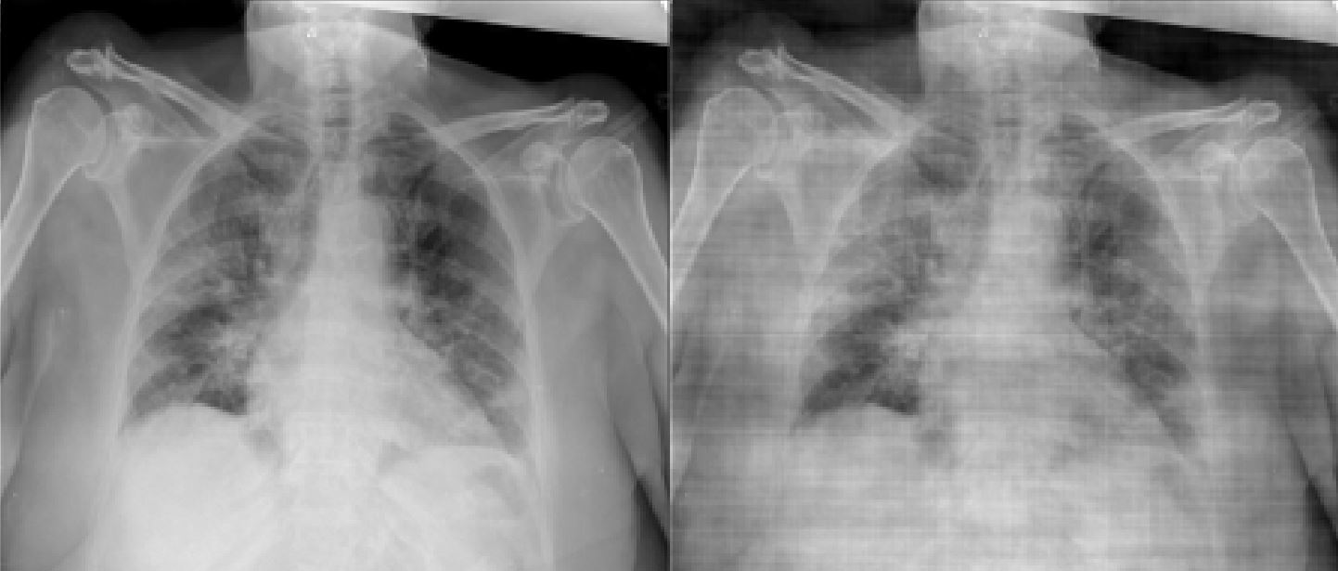
Proposal II
Methodology ( Texture Augmentation)
CXR Image
Fourier transform
Frequency spectrum
Normal Noise with
Mean = 1.0, Std = .3
*
Inverse Fourier transform
Augmented CXR Image

Slide 50
Proposal II
Methodology
Network design principle
Any linear combination is followed by Batch Norm.[9]
ReLU is used for as activation function.[10]
For the same block Dense Residual Connection is included.[11]
Dropout layer is added as a first layer of FullyConn layers.[12]
Max Norm Constrain.
Thin architectures and small Kernel size (3x3).
[9] Ioffe, Sergey, and Christian Szegedy. "Batch normalization: Accelerating deep network training by reducing internal covariate shift." International conference on machine learning. PMLR,
[10] Krizhevsky, Alex, Ilya Sutskever, and Geoffrey E. Hinton. "Imagenet classification with deep convolutional neural networks." Advances in neural information processing systems 25 (2012).
[11] Zhang, Yulun, et al. "Residual dense network for image super-resolution." Proceedings of the IEEE conference on computer vision and pattern recognition. 2018.
[12] Srivastava, Nitish, et al. "Dropout: a simple way to prevent neural networks from overfitting." The journal of machine learning research 15.1 (2014)

Slide 51
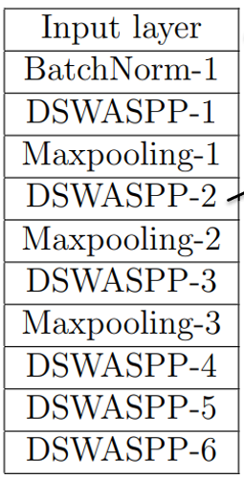
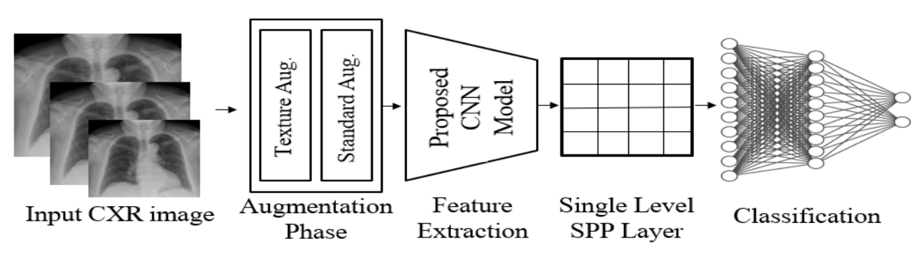
Proposal II
Methodology ( Proposed Architecture )

Slide 52
Proposal II
Methodology ( Proposed Architecture )
Dense spatial weighted Atrous Spatial pyramaid pooling (DSWASPP)
C_{in}xHxW
SWASPP
SWASPP
SWASPP
C_{in}xHxW
Attention Module
Conv3x3,32,r=1
Conv3x3,32,r=1
Conv1x1,C_{in}
x
Conv3x3,32,r=2
Conv3x3,32,r=2
Conv1x1,C_{in}
x
+
C_{in}xHxW
C_{in}xHxW
Conv3x3,32,r=3
Conv3x3,32,r=3
Conv1x1,C_{in}
x
Conv1x1,C_{in}
x
Notes:
For SWASPP input feature map in process using three pipelines in parall.
The three pipelines are shared parameter and only only deffer on the atrous rate.
Result for each pipeline represent a particular scale.
To allow efficient us of the computational padget we’ve impelemneted the a bottleneck within the pipeline which the input is projected to thirty two and then projected back using a projection layer.
To fuse the features we used an attention module that is responsible for selecting at which scale the network should operat.

Slide 53
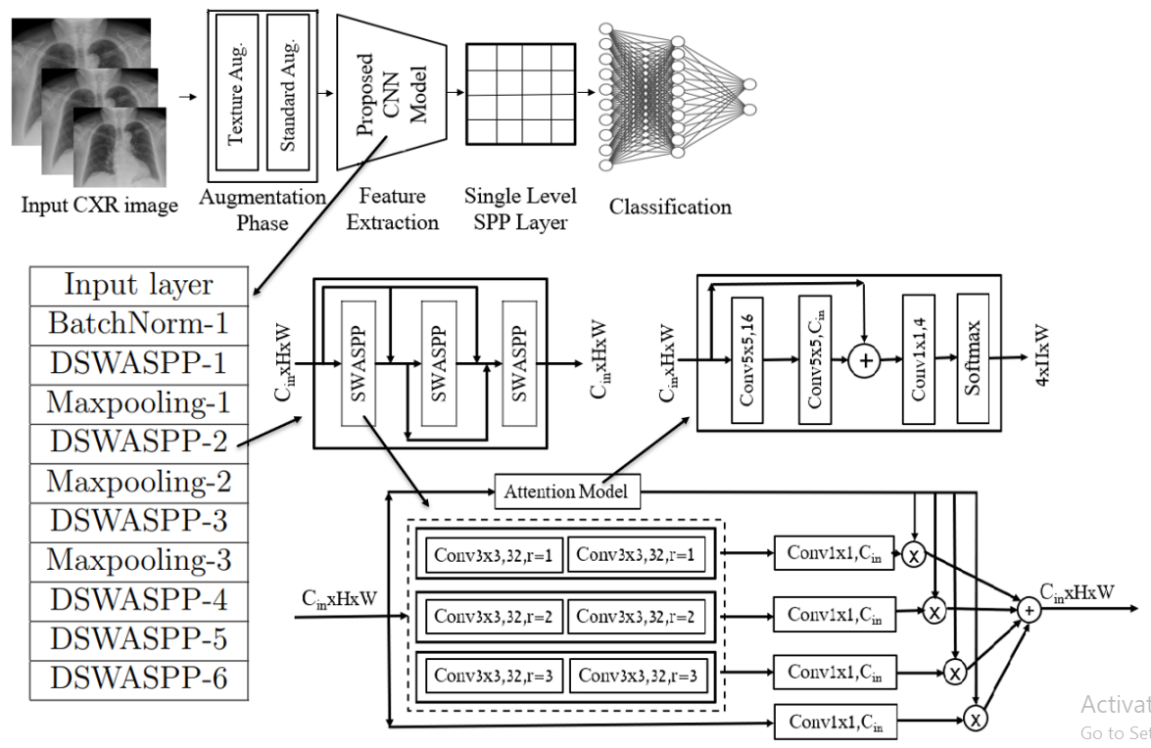
Proposal II
Attention module of SWASPP
C_{in}xHxW
Conv5x5,16
Conv5x5,C_{in}
+
Conv1x1,4
4xHxW
Softmax
Notes:
Attention mudule output four heatmaps these heatmaps sumup to one
Attention module can be thought of a pixel level classification.
It selects for each pixel what it correct scale.

Slide 54
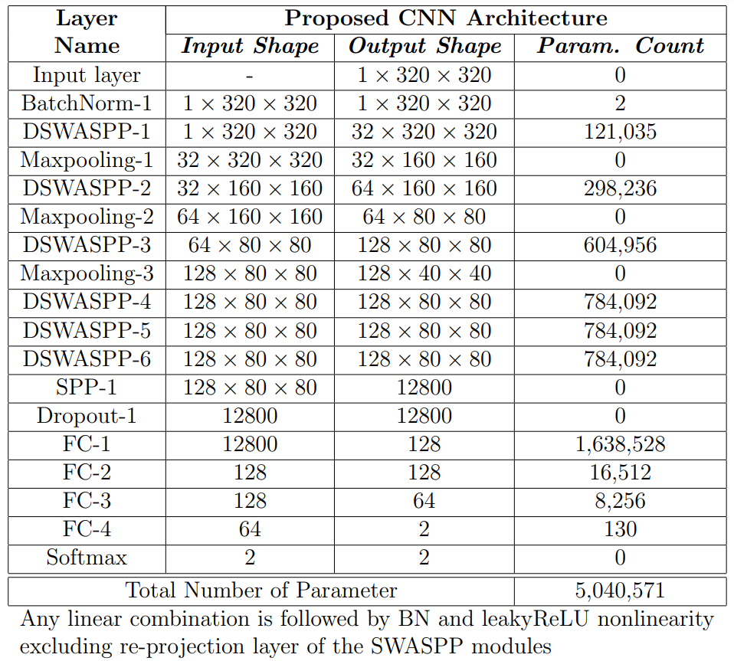
Proposal II
Methodology
(overall Architecture)

Slide 55
Experimental Results II
Experiment is conducted on (Tesla P-100) 16GB GPU and 32 GB Ram using Pytorch Using QATA-COV-19 dataset (balanced Number of labels for classes)
All models have the same settings
Num of epochs 200.
Adam optimizer with dynamic learning rate.
Batch size is 256.
Cross Entropy loss.
Train validation test is 0.6 0.1 0.3, respectively.

Slide 56
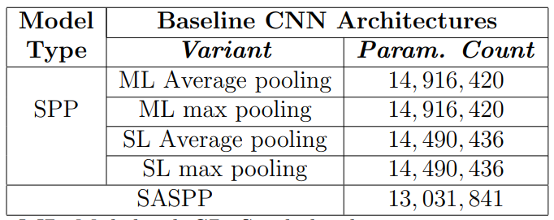
Experimental Results II
Base Networks for initial comparison.

Slide 57
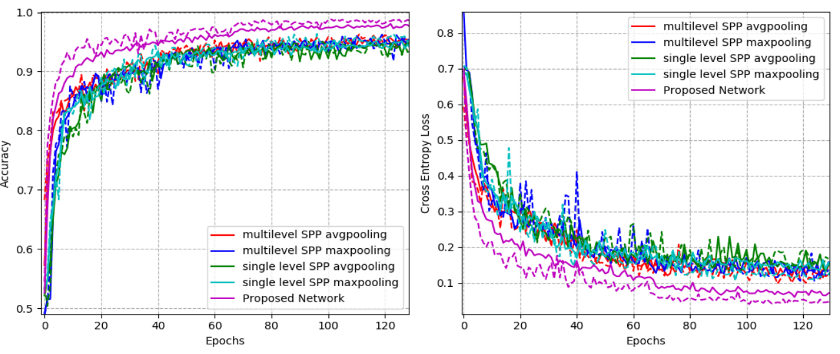
Experimental Results II
Base Networks for initial comparison.

Slide 58
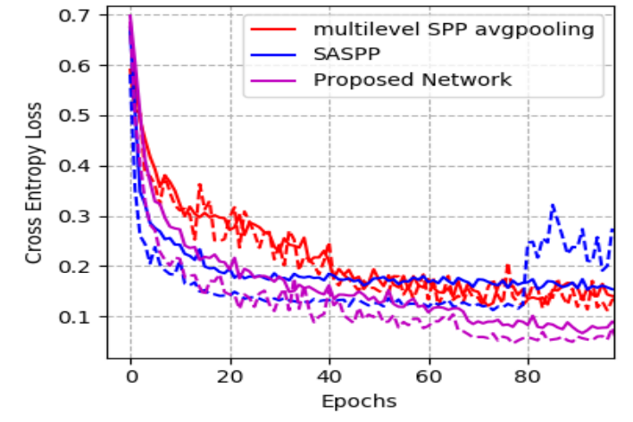
Experimental Results II
Base Networks for initial comparison.

Slide 59
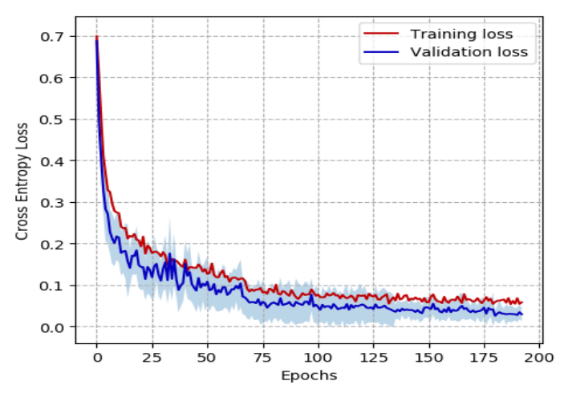
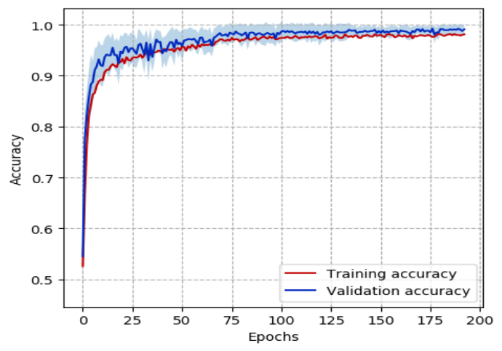
Experimental Results II

Slide 60
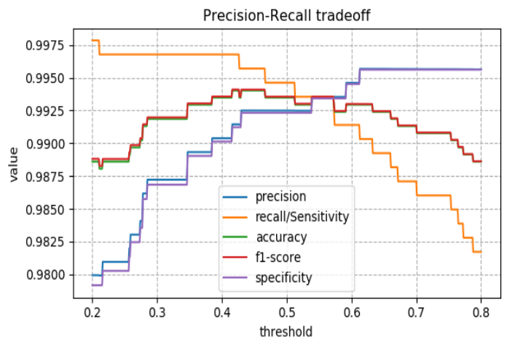
Experimental Results II

Slide 61
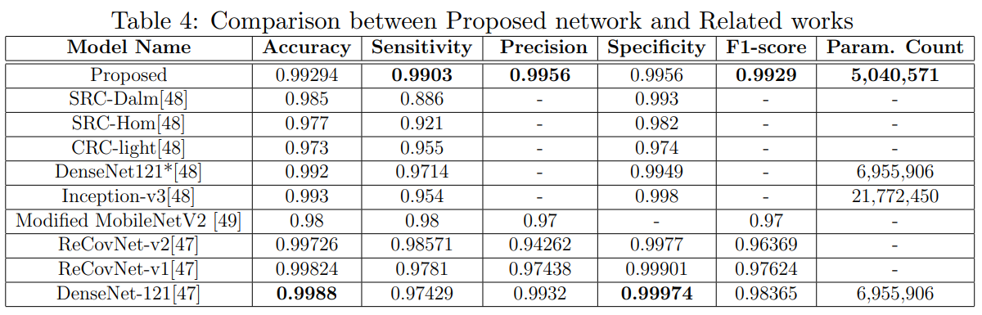
Experimental Results II

Slide 62
Table of The Content
Introduction
Problem Statement
Related Work
Proposed Work I
Proposed Work II
Conclusion

Slide 63
Conclusion
Novel light-weight and scale invariant CNN architecture for COVID19 classification.
Lightweight architecture achieved a superior performance 100%
Spatial separable kernels is used to reduce parameter count.
Atrous Spatial pooling is used to construct the scale space.
Trainable Attention module is used to guide the network across the scale space.
proposed works outperformed prior work.
proposed method II achieved a 99.03 for sensitivity.

Slide 64
Conclusion
Comparison Between Two the two methods
 | Proposed Method I | Proposed Method II
Parameter Count | 150K | 5M
Scales Invariance | No ( accuracy drops to 93% ) | Yes (performance Not affected)
Training Time | Short ( 20 epoch ) | Long ( 200 epoch )
Stable | No ( affected by Acquisition Device ) | Yes ( texture and scale augmentation )
Fast Evaluation | Yes | No

Slide 65
References
[1] Szeliski, Richard. Computer vision: algorithms and applications. Springer Science & Business Media, 2010.
[2] Van Noord, Nanne, and Eric Postma. "Learning scale-variant and scale-invariant features for deep image classification." Pattern Recognition 61 (2017): 583-592.
[3] Lowe, David G. "Distinctive image features from scale-invariant keypoints." International journal of computer vision 60.2 (2004): 91-110.
[4] Simonyan, Karen, and Andrew Zisserman. "Very deep convolutional networks for large-scale image recognition." (2014).
[5] He, Kaiming, et al. "Spatial pyramid pooling in deep convolutional networks for visual recognition." IEEE transactions on pattern analysis and machine intelligence 37.9 (2015): 1904-1916.
[6] Lin, Tsung-Yi, et al. "Feature pyramid networks for object detection." Proceedings of the IEEE conference on computer vision and pattern recognition. 2017.
[7] Chen, Liang-Chieh, et al. "Deeplab: Semantic image segmentation with deep convolutional nets, atrous convolution, and fully connected crfs." IEEE transactions on pattern analysis and machine intelligence 40.4 (2017): 834-848.

Slide 66
References
[8] Qiao, Siyuan, Liang-Chieh Chen, and Alan Yuille. "Detectors: Detecting objects with recursive feature pyramid and switchable atrous convolution." Proceedings of the IEEE/CVF Conference on Computer Vision and Pattern Recognition. 2021.
[9] Ioffe, Sergey, and Christian Szegedy. "Batch normalization: Accelerating deep network training by reducing internal covariate shift." International conference on machine learning. PMLR, 2015.
[10] Krizhevsky, Alex, Ilya Sutskever, and Geoffrey E. Hinton. "Imagenet classification with deep convolutional neural networks." Advances in neural information processing systems 25 (2012).
[11] Zhang, Yulun, et al. "Residual dense network for image super-resolution." Proceedings of the IEEE conference on computer vision and pattern recognition. 2018.
[12] Srivastava, Nitish, et al. "Dropout: a simple way to prevent neural networks from overfitting." The journal of machine learning research 15.1 (2014): 1929-1958.
[13] Degerli, Aysen, et al. "Reliable COVID-19 Detection Using Chest X-ray Images." 2021 IEEE International Conference on Image Processing (ICIP). IEEE, 2021.

Slide 67
References
[14] M. Ahishali et al., "Advance Warning Methodologies for COVID-19 Using Chest X-Ray Images," in IEEE Access, vol. 9, pp. 41052-41065, 2021
[15] Yamac, Mehmet, et al. "Convolutional sparse support estimator-based COVID-19 recognition from X-ray images." IEEE Transactions on Neural Networks and Learning Systems 32.5 (2021): 1810-1820.
[16] Chorowski, J. K., Bahdanau, D., Serdyuk, D., Cho, K., & Bengio, Y. (2015). Attention-based models for speech recognition. Advances in neural information processing systems, 28.
[17] Vaswani, A., Shazeer, N., Parmar, N., Uszkoreit, J., Jones, L., Gomez, A. N., ... & Polosukhin, I. (2017). Attention is all you need. Advances in neural information processing systems, 30.

Slide 68
Thank You.

